Slide 1
Ancient Greece
Chapter 4, section 1: Early People of the Aegean

Slide 2
Homework
Read Pages 77-79 and define terms in bold.

Slide 3
“Do not spoil what you have by desiring what you have not; remember that what you now have was once among the things you only hoped for.”
Epicurus quotes (Greek philosopher, BC 341-270)

Slide 4
Pre-Test
The Ancient Greeks owned slaves
Women could vote in democratic Athens
Were most city states actually cities?
Was the secret of Greece’s success its rich, fertile land?
Did the ancient Greeks value wealth above all else?

Slide 5
Pre-Test
The Ancient Greeks owned slaves
  True – Even democratic Athens had no second thoughts about owning slaves.
Women could vote in democratic Athens
  False –However, women had more power over their lives in Sparta, which was Athens rival.
Were most city states actually cities?
  False – the vast majority were only small towns of a few hundred citizens
Was the secret of Greece’s success its rich, fertile land?
  False – the mountainous terrain was only suitable for a few select crops like olives.
Did the ancient Greeks value wealth above all else?
  False – fame and honor meant much more to the average Greek citizen than wealth.

Slide 6
Define in your own words:
Democracy
  Democracy is a form of government in which all eligible citizens are meant to participate equally – either directly or, through elected representatives, indirectly – in the proposal, development and establishment of the laws by which their society is run. The term originates from the Greek δημοκρατία (dēmokratía) "rule of the people"
Republic
  A republic is a form of government in which power resides in the people,^{[1]} and the government is ruled by elected leaders run according to law (from Latin: res publica), rather than inherited or appointed (such as through inheritance or divine mandate). In modern times the definition of a republic is also commonly limited to a government which excludes a monarch.^{[1][2]} Currently, 135 of the world's 206 sovereign states use the word "republic" as part of their official names.

Slide 7
Agree / Disagree
GEOGRAPHY:
The growth of civilizations is decided by their geography
  Agree: The geography of a region must allow for good transportation and communication in order for civilizations to develop
  Disagree: A civilization can develop even if the terrain isolates towns and cities.

Slide 8
Citizenship
CITIZENSHIP:
The best way for governments to rule is to limit the number of people who can be citizens.
  Agree: A gov can rule best if decisions are made by only a limited number of citizens.
  Disagree: A gov rules best when all members of society are invited to participate as citizens.

Slide 9
Global Relations
Global Relations:
People often go to war to gain respect for their country.
  Agree: The development of an advanced and respected civilization often requires military dominance.
  Disagree: War mongering societies are often seen as barbarians not worthy of respect

Slide 10
Impact of Geography
The rugged terrain of ancient Greece led to the development of many different independent city-states.
Mountains
The city states formed south of the mountains, or in the valleys between them.
Isolation
Because they were isolated, the Greek city states each had their own distinct culture.
This isolation also prevented unification of the Greek city-states.

Slide 11
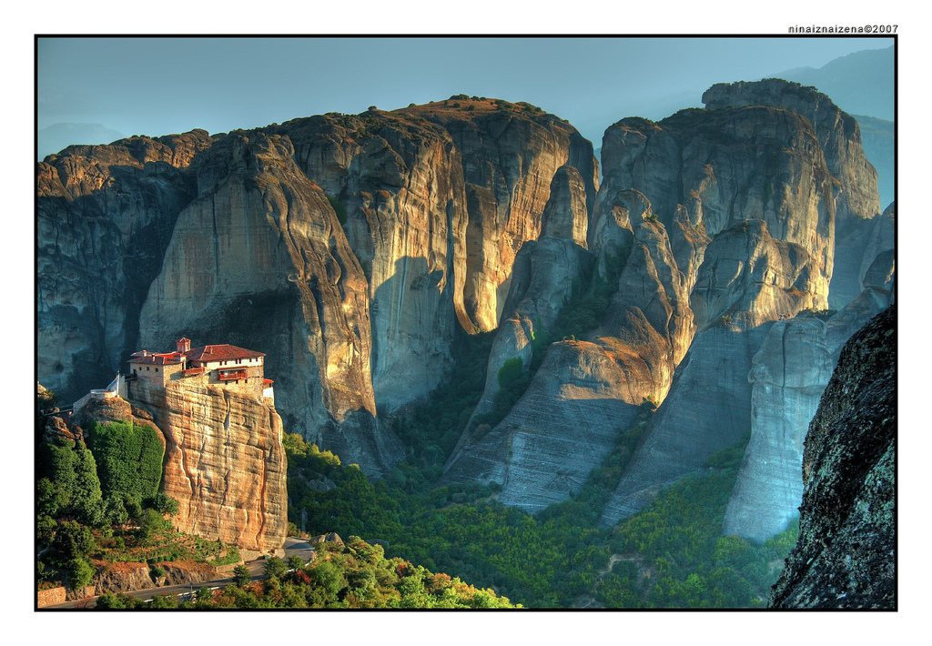
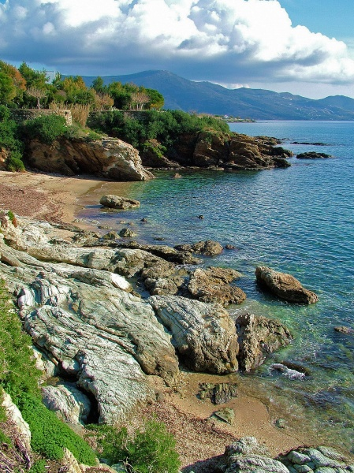
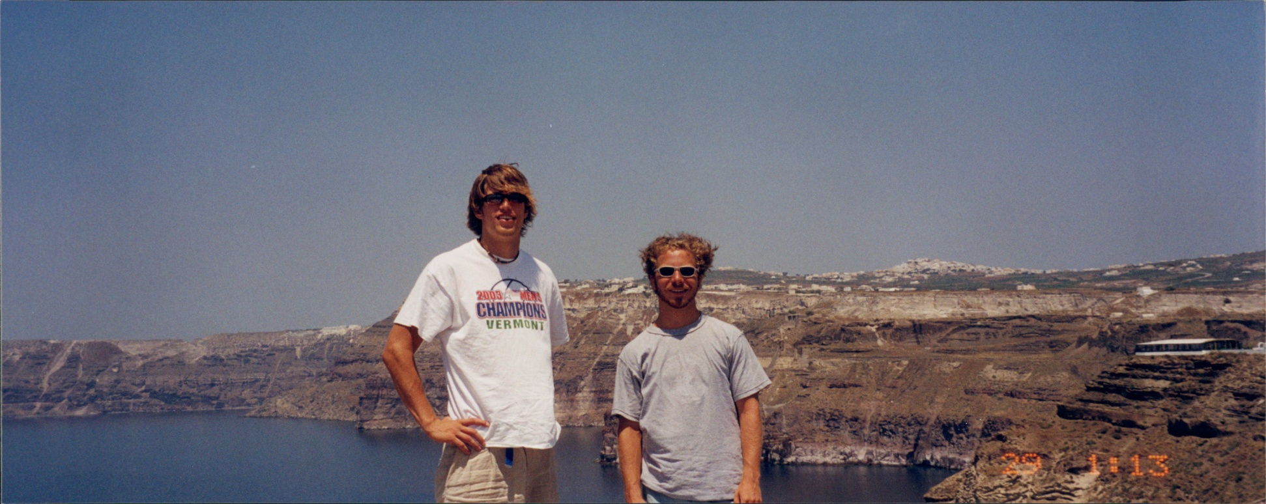

Slide 12
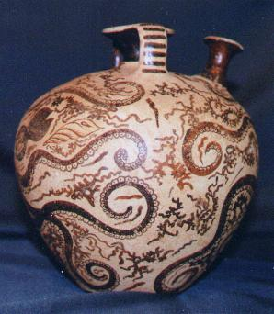
Seas
The Greek city-states were located around the Aegean Sea, near the Mediterranean Sea. Advantage?
Seafaring
Many of the Greek city-states developed trading fleets to trade with the surrounding areas.
They had limited agricultural resources, so trade was necessary. (Interdependence)
The soil of ancient Greece was poor and not good for agriculture.

Slide 13
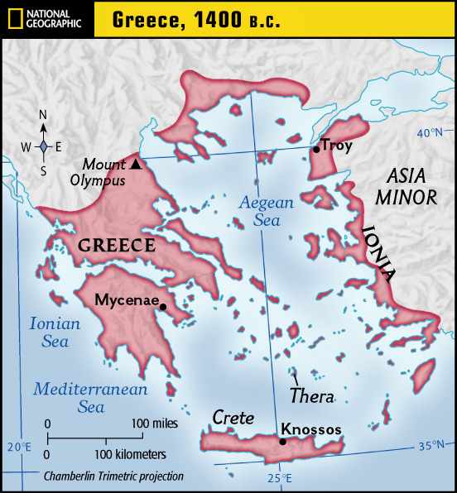
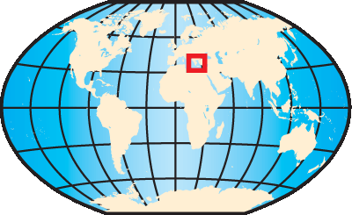

1. Minoan

Slide 14
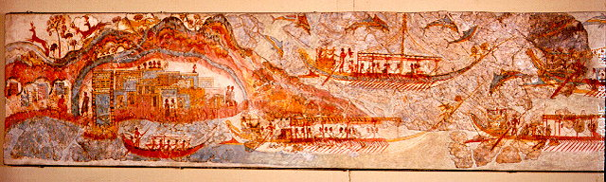
Minoan Civilization (2700-1450 B.C.)
Was a complex and rich culture based on the Aegean island of Crete.
Crete Largest island in the Aegean
Knossos Great Minoan city on Crete. Home to king Minos, after whom the Minoan are named.
Trading Empire
Objects of Minoan manufacture suggest there was a network of trade with mainland Greece (notably Mycenae), Cyprus, Syria, Anatolia, Egypt, Mesopotamia, and westward as far as the coast of Spain .
Through contact with Egypt and Mesopotamia, they acquired ideas and technology in fields such as writing and architecture.

Slide 15
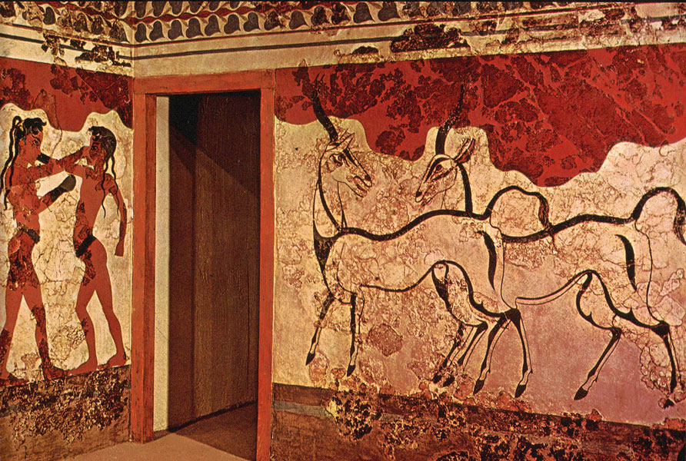
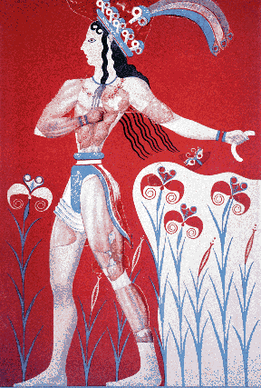
Destruction
In 1400 B.C., Minoan civilization vanished.
The reason for the destruction of the Minoan civilization is uncertain.
It may have been a natural disaster such as a volcanic eruption, earthquake, or drought.
It is certain that invaders did play some role in the destruction of Minoan civilization.
.

Slide 16
2. Mycenaens

Slide 17
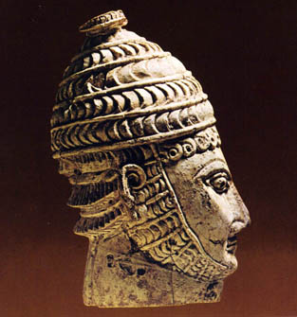
Mycenaeans (My SUH NEE unz)
First people to speak Greek
Mycenaean Civilization
(1400-1200 B.C.)
Arose after the defeat of the Minoans
Dominated the Aegean world from about 1400 B.C. to 1200 B.C.
Were great sea traders. Learned many skills from the Minoans, including art and writing. Where did they learn these from?
- Egyptian and Mesopotamian customs.

Slide 18
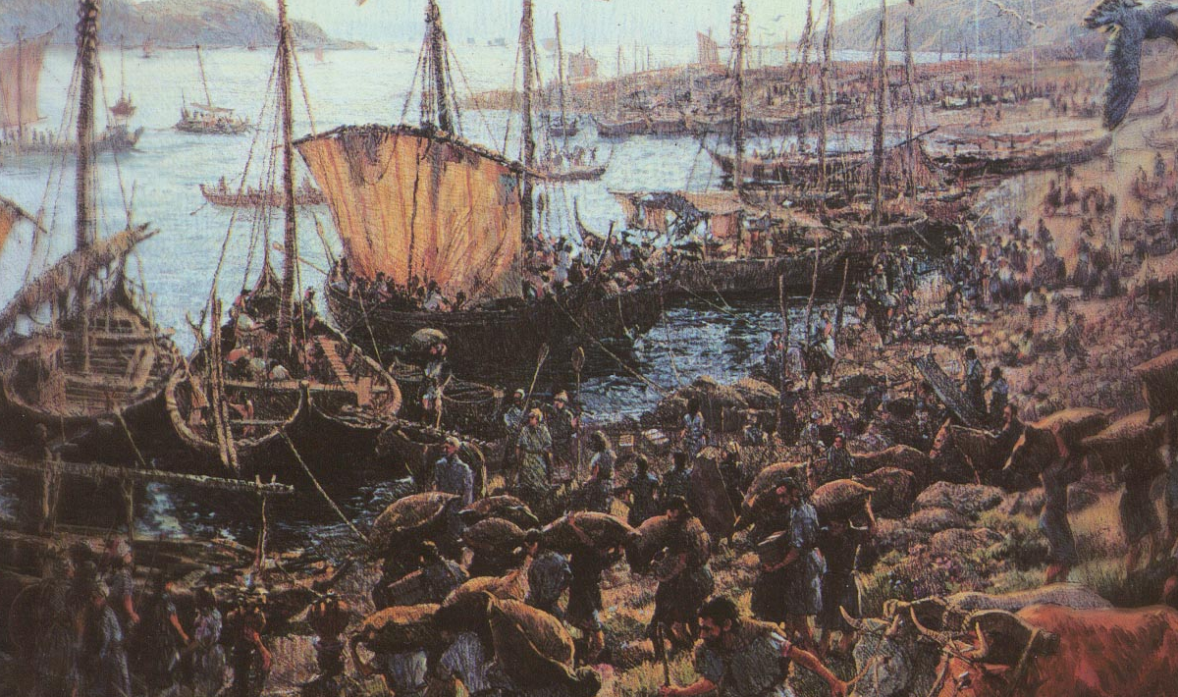
They lived in separate city-states on the mainland.
In each, a warrior-king built a thick-walled fortress from which he ruled the surrounding villages.

Slide 19
The Trojan War
Took place around 1250 B.C.
The conflict was based on an economic rivalry between Mycenea and Troy, a rich trading city in present day Turkey.
Looking at map, why economic conflict?

Slide 20
Black Sea
Bosporus
Aegean Sea
Black Sea
Dardanelles (Hellespont)
Access to Black Sea
Bosporus
Access to Black Sea
Crete
Knossos
Center Minoan civ.
Troy
Controlled Dardanelles
Dardanelles
Troy
Aegean
Sea
Mycenae
Crete
Knossos

Slide 21
Why?
Troy controlled the vital straits, or narrow water passages, connecting the Mediterranean and Black seas.

