Slide 1
Tuesday, Sept. 1nd, 2015
Journal – Attendance
Civilization Notes (Cause / Effect)

Slide 3
Journal
“People are always neglecting something they can do in trying to do something they can’t do.”
– Edgar Watson Howe

Slide 4
Cause and Effect
A cause is something that makes something else happen. Out of two events, it is the event that happens first.
An effect is what happens as a result of the cause. Of two related events, it’s the one that happens second or last.

Slide 5
Cause and Effect
Example
  CAUSE
    Fire was discovered
  EFFECT
    People could move to new regions because they could keep warm

Slide 6
Review –Advantages of a Settled Life
Hunting and gathering moved to ____________.
  Farming and raising animals
How did farming provide more rewards than hunting and gathering?
  Steady supply of food
  Could stay in one place

Slide 7


Advantages of a Settled Life
When people had more food than they needed this is called a food __________.
  Surplus

Slide 8
Advantages of a Settled Life
Cause:
  People had a steady supply of food
Effects:
  People could stay in one place
  Food could be stored for use at another time

Slide 9
Population Growth
Cause:
  Hunting and gathering DID NOT produce a surplus of food
Effect on family life:
  Not many children, because they could not feed them all

Slide 10
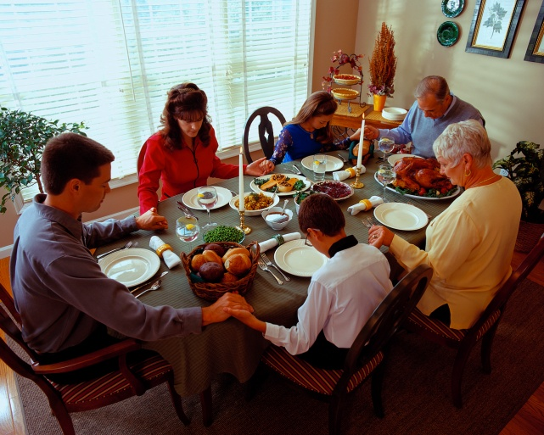

Population Growth
How did surpluses of food affect family size?
  People could now have larger families
How did surpluses of food affect population growth?
  Large families brought a rapid population growth to the world

Slide 11
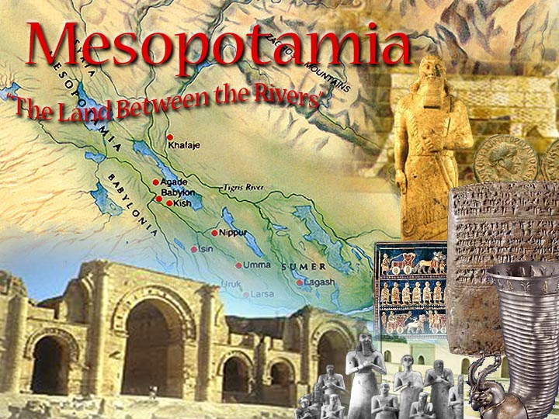

Slide 12
The First Civilizations
A _____________ is a society that has cities, a central government run by official leaders, and workers who specialize in various jobs.
  Civilization

Slide 13
The First Civilizations
Characteristics of a civilization
  Cities
  A central government run by official leaders
  Workers who specialize in various jobs
  Art, architecture, writing, record keeping
  Class divisions

Slide 14
The First Civilizations
How does the creation of a civilization lead to social classes?
  Different jobs means different statuses in society

Slide 15
First Cities
The first cities grew around rivers, why?
River water was vital for good farming
Rivers also provided a way to travel and trade easily
In some cities large markets formed where people could trade or barter for goods.

Slide 16
“The Cradle of Civilization”
Mesopotamia is often called the “Cradle of Civilization” because it is where the first civilizations began.
The earliest of these civilizations was located in the southern region of Mesopotamia called Sumer.

Slide 18
Long-Term Causes
Neolithic people learn to farm
Silt deposits create fertile soil in river valleys
Gov Emerges
Early civilizations conquer neighboring lands
Clash with nomadic people
Long-Term Effects
H&G settle into farming communities

Slide 19
Immediate Causes
New technologies improve farming
Food surpluses support rising populations
Complex forms of government develop
Job specialization leads to social classes
Immediate EffectsEffects
First cities built in Fertile valleys
Farmers cooperate to control flooding

Slide 20
Wednesday, Sept. 3rd
Meso notes cont.
HELP WANTED!

Slide 21
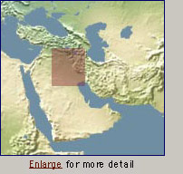
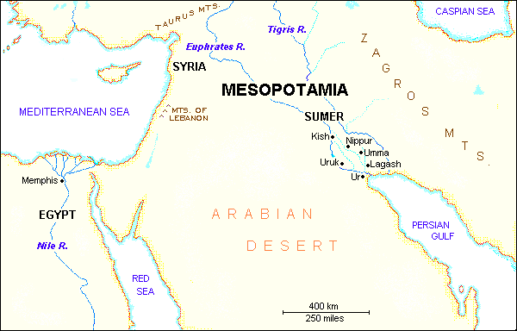
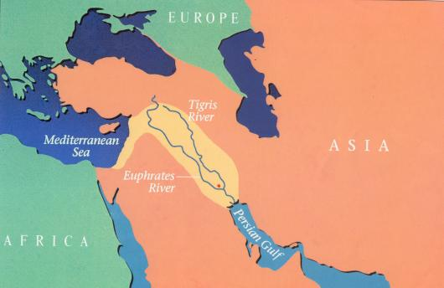
Early River Valley Civilizations
City-States in Mesopotamia
I. GEOGRAPHY
A. Mostly dry desert climate in SW Asia (Middle East)
1. Except in region between Tigris / Euphrates rivers
2. a flat plain known as Mesopotamia lies between the
two rivers
3. Because of this region’s shape and the richness of its soil,
it is called the Fertile Crescent.
- the rivers flood at least once a year,
leaving a thick bed of mud called silt.
SW Asia
(the Middle East)
Fertile Crescent
PP Design of T. Loessin; Akins H.S.

Slide 22
Early River Valley Civilizations
City-States in Mesopotamia
I. GEOGRAPHY
3. Because of this region’s shape and the richness of it’s soil,
it is called the Fertile Crescent.
- the rivers flood at least once a year,
leaving a thick bed of mud called silt.
Sumerians were first to settle in this region, attracted by the rich soil.
B. Three Disadvantages / Environmental Challenges
1. Unpredictable flooding / dry summer months
2. No natural barriers for protection
- small villages lying in open plain were defenseless
3. Limited natural resources
- stone, wood, metal
PP Design of T. Loessin; Akins H.S.
PP Design of T. Loessin; Akins H.S.

Slide 23
Disadvantage #1:
The Rivers rarely flooded at the same time each year. Sometimes they flooded as early as March and other times they did not flood until May. After the flood receded the sun quickly dried the silt into hard clay. How could the Sumerians continue to water their fields with little or no rainfall during the growing season?
Sometimes the flood never came. What would be some ways that the Sumerians tried to ensure the flood would come?

Slide 24
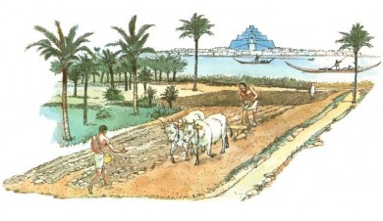
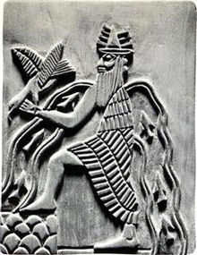
The Sumerians constructed irrigation systems to carry river water to fields. This allowed them to produce large amounts of food.
Sumerians prayed to and gave sacrifices to Enki-the river god. They asked for a strong enough flood to provide plenty of water but not too strong a flood that might be devastating.

Slide 25
Irrigation Systems
Cause:
  People dug canals and built dams
Effect:
  Crops could be irrigated during the dry summers
  Why are irrigation systems useful to people?
    Help to water crops during dry periods.

Slide 26
Disadvantage #2:
Sumerian city-states stood on open plains. Natural defenses could not provide barriers to invading groups of warriors. How could the city-states defend or protect themselves?

Slide 27
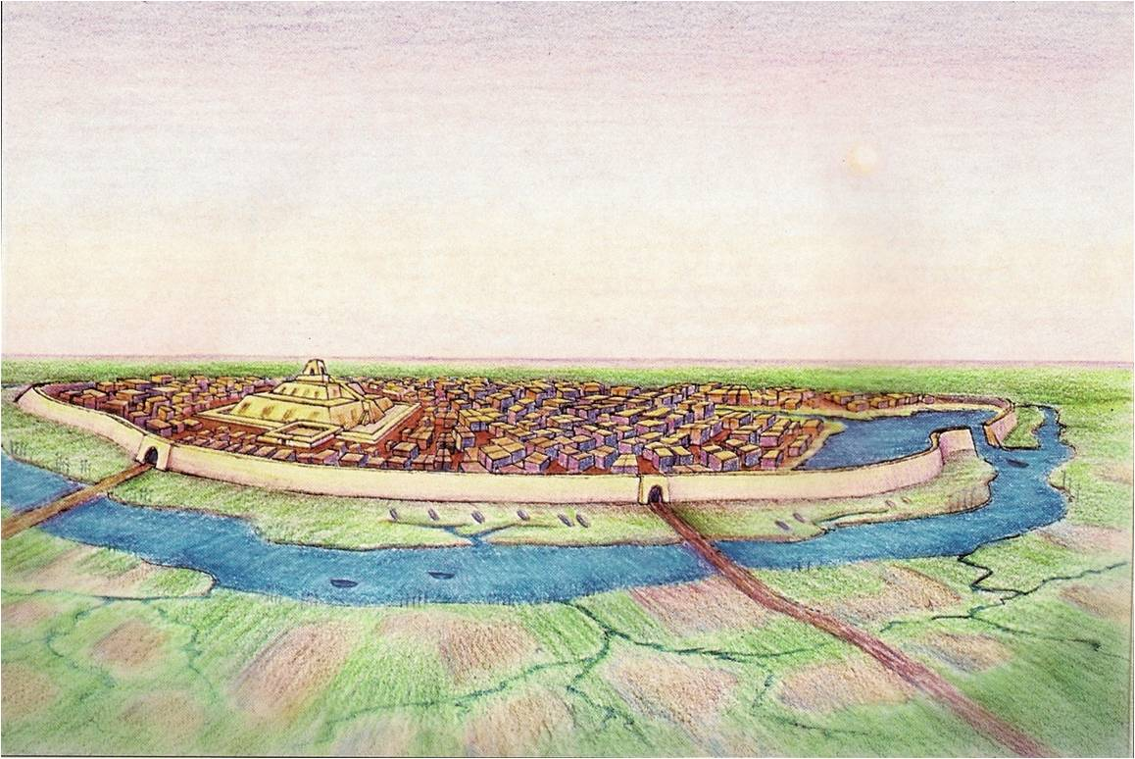
The Sumerians built city walls out of mud bricks that surrounded the city.

Slide 28
Disadvantage #3:
Natural resources were very limited. In the desert region, how did the Sumerians get resources such as stone, wood, and metal for tools and building?

Slide 29
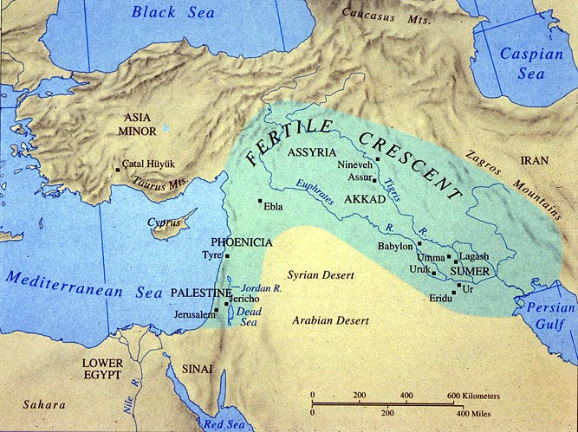
The Sumerians traded grain, cloth, and tools for products they lacked. They usually traded with northern Mesopotamian city-states which were located in places that had timber and metals.
Mountains provided timber and metals.

Slide 30
Sumerian Government
The need to control the water supply and irrigation system made it necessary for someone to be in charge
The Sumerians established governments and systems of rules so they could maintain law and order.
In times of peace, priests were in charge but during war a strong warrior took over.
Because the city-states were constantly at war, warriors ruled mostly
The warriors became Kings. When one King died his son then ruled This is called a dynasty.

Slide 31
END

Slide 32
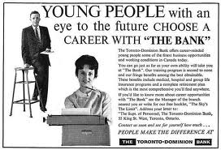

Slide 33
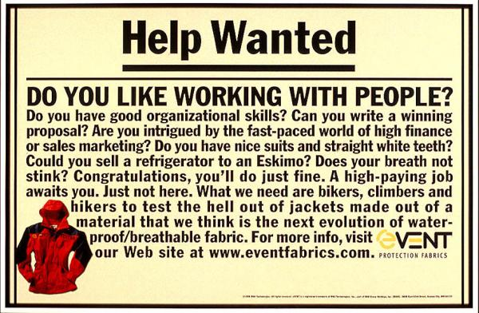

Slide 34
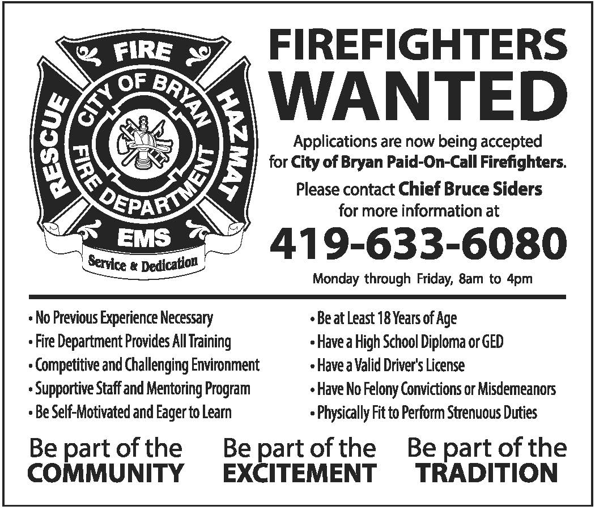

Slide 35
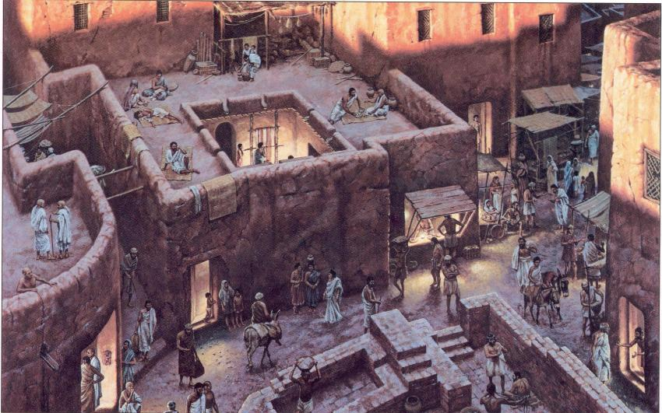
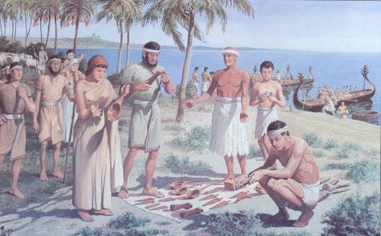
Chapter 2 Lecture Outline: “The Four Early River Valley Civilizations”
City-States in Mesopotamia
I. GEOGRAPHY
Sumerians were first to settle in this region, attracted by the rich soil.
B. Three Disadvantages / Environmental Challenges
1. Unpredictable flooding / dry summer months
2. No natural barriers for protection
- small villages lying in open plain were defenseless
3. Limited natural resources (stone, wood, metal)
C. Solutions
Sumerian innovations in achieving civilization
set example others would follow.
But to arrive at these solutions,
required organized government.
1. Irrigation ditches
2. Built city walls with
mud bricks
3. Traded with people
around them
for the products
they lacked.
Initiated Bronze Age.
PP Design of T. Loessin; Akins H.S.
PP Design of T. Loessin; Akins H.S.

Slide 36
Tigris and Euphrates River Valley
Mesopotamia is located between these rivers. Mesopotamia is a Greek word that means “land between the rivers”
The rivers flow from the mountains of Asia Minor southeast to the Persian Gulf
Almost every spring the rivers flooded their banks and deposited a thick layer of silt.
The silt stuck to the ground and created a rich fertile area to plant crops. That is why the region was also called the Fertile Crescent because of the rich soil and curved shape.

Slide 37
“The Cradle of Civilization”
Mesopotamia is often called the “Cradle of Civilization” because it is where the first civilizations began.
The earliest of these civilizations was located in the southern region of Mesopotamia called Sumer.

Slide 38
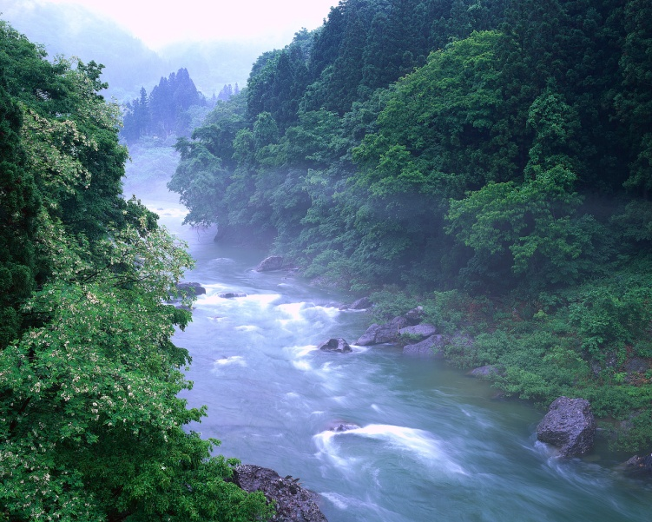
Big Rivers
What big rivers did early cities grow up along?
  Nile in Egypt
  Tigris and Euphrates in Iraq
  Huang He in China
  Indus River in Pakistan

