Slide 2
List 10 changes in America since 1800.

Slide 3
What does it mean to be “enlightened”?
Free from ignorance, prejudice, or superstition.
Enlightenment philosophers emphasized political goals like individual freedom and limited government.

Slide 4
Which do you MOST agree w/?
Freedom of speech should always be protected.
Freedom of speech should be restricted during times of war.
Freedom of speech should be restricted if it harms someone.
Freedom of speech should be restricted if it endangers someone’s life.

Slide 5
England 1643
John Milton, Puritan writer, expressed views about freedom of expression that later influenced Enlightenment thinkers:
“Give me liberty to know, to utter, and to argue freely according to conscience, above all liberties.”

Slide 6
China 1957
Mao Zedong led a government in China based on the ideals of the communist philosopher Karl Marx:
“ What should our policy be toward non-Marxist ideas? As far as unmistakable counterrevolutionaries and aboteurs of the socialist cause are concerned, the matter is easy. We simply deprive them of their freedom of speech”

Slide 7
United States 1942
Uncle Sam silences an American who is careless in his speech during WWII:
“ “Loose talk” could reveal important secrets to the enemy, costing American lives.

Slide 8
ECONOMICS: A growing economy benefits all people
Agree: Jobs and goods are plentiful when an economy is growing.
Disagree: Only those with money and freedom can benefit from a growing economy.

Slide 9
CULTURE: Religious differences lead to conflict and bloodshed.
Agree: Conflict occurs when one group tries to impose its religion on another group.
Disagree: Religious differences enrich a society.

Slide 10
SCIENCE, TECH, & SOCIETY: Technology that improves the quality of life for individuals can prove harmful to society as a whole.
Agree: Tech gives a small percentage of people a high standard of living at the expense of the world’s environment.
Disagree: Advances in tech benefit all people

Slide 11
What would school be like with no rules?
Are people basically good or bad?
What is government? Kinds – Monarchy (Kings) - Democracy - Anarchy (no govt)
What are rights? Where do they come from?

Slide 12
AGE OF REASON - Questionnaire
Below are some ideas about how people should be governed. The Age of Reason was very concerned about how society should be governed. Indicate whether you AGREE or DISAGREE with the ideas.
The government should encourage people to be religious by such things as having prayer in schools because it will make people behave better.
No one should have the right to oppose the majority will of the people.
The police should have the right to enter a person’s house and search it if they suspect the person is a criminal.
A policeman who catches a person committing a violent crime such as mugging an old lady should be allowed to shoot the criminal on the spot.
The best way to make the rules for society is to elect people to make them.
A person should be allowed to say what they want even if others don’t like it.

Slide 13
Creating Own Government

Slide 14
DAY 4 - ENLIGHTENMENT
Day after creating your own government.

Slide 15
CREATING YOUR OWN GOV: DEBRIEF

Slide 16
John Locke (1632-1704),
NATURAL RIGHTS:
Argued that man was originally born into a state of nature where he was rational, tolerant, and happy.
In this original existence man was entitled to enjoy the rights of life, liberty and property.

Slide 17
THE ENLIGHTENMENT
Many ideas from the Enlightenment were eventually adopted by countries in Europe and around the world. Ideas even spread to the United States and are today a part of our way of life.
Read each statement by the philosophes below and decide whether the statement is a true description of present American life. If it is true of the United States today, answer YES, if the idea or attitude is not true of present life in the US, put NO.

Slide 18
JOHN LOCKE
All men are free and equal at birth.
Everyone has the right to life, liberty, and the ownership of property.
Citizens have the right to overthrow the government when their “natural rights” are violated.

Slide 19
MONTESQUIEU
An absolute ruler is an undesirable leader because one man rule limits such basic freedoms as speech, press, and religion.
There should be a “separation of powers” in government between legislative, executive, and judicial branches.
When one country increases its military power, so do other countries, therefore, all nations should limit their military strength in order to reduce the chances of war.

Slide 20
VOLTAIRE
A man should not be persecuted because of his religious beliefs.
All men should be treated as equals, and should have freedom of speech and freedom of the press.
Democracy is not a good form of government because the common people are not capable of governing themselves: the best government is one headed by a good and fair king.

Slide 21
ROUSSEAU
It is unfair that some people are rich while other people are poor.
The rich should not enjoy special privileges.
Compared to man during the Stone Age, modern man is unhappy, insecure, and greedy.

Slide 22
If the philosophes were alive today, do you think they would be generally satisfied or dissatisfied with social conditions and the type of government we have in the United States? Explain your answer.

Slide 23
Not all philosophes had the same beliefs, but most agreed that
Reason should be used at all times
The search for new knowledge and ideas should continue
Improvements must be made in the system of justice to end unfair jail sentences, the torture of prisoners, and terrible conditions in prisons
Slavery and warfare should be done away with.
Freedom of religion, speech, and the press must be given to all.
Everyone should enjoy liberty and equality
There should be public education for all, not just school for children of the rich

Slide 24
Enlightenment Philosophes

Slide 25
INTRO FRENCH REV
Worksheet – THE REIGN OF LOUIS XIV

Slide 26
THE POLITICS OF REVOLUTION
“REVOLUTION” – Define
What are some common reasons people might revolt?
What kind of person do you think typically leads a revolution?
Do you think a revolution is something that happens quickly or over time? Why?
Once a government has been overthrown, how long do you think it would take for new leaders to establish a different form of government and make it run effectively?

Slide 27
FREE PRESS AND REVOLUTIONS
FINISH COMPARING REV WS
MOVE TO FREE PRESS & REV

Slide 28
FREE PRESS AND REVOLUTIONS
DEFINE:
Free press censorship propaganda fact opinion rumor / gossip
Why would a person , group or government:
Be opposed to freedom of the press?
Censor information being presented to the public?
Distribute propaganda to the public?
How could having complete control of the press give a person, group or gov more power?
How has the technological revolution and the development of new forms of press such as web, blogs, twitter, changed ability of people, groups and gov to control the press?

Slide 29
Work with a partner to brainstorm answers to the following questions. Be prepared to discuss your answers in class.
What are the positive aspects of living in a country where free press is allowed? Provide specific examples to support your ideas.
What are the negative aspects of living in a country where free press is allowed? Provide specific examples to support your ideas.

Slide 31
Hobbes & Locke
Hobbes wrote in his masterwork, the Leviathan (1651), that men were motivated primarily by the desire for power and by fear of other men, and so needed an all powerful sovereign to rule over them.
He characterized their lives without a strong ruler as solitary, nasty, poor, brutish, and short.

Slide 32
Locke
Government was a contract between ruler and subjects: rulers were granted power in order to assure their subjects welfare

Slide 33
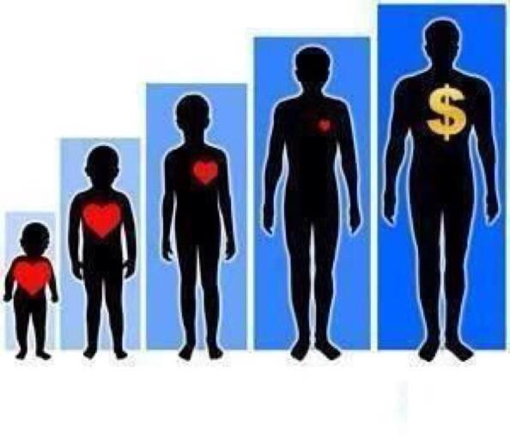
1. Are people naturally cruel, greedy, and selfish or are people basically reasonable and moral? Explain.
2. If there are not established laws, would people fight, rob, and attack one another without constraint or a guilty conscience?
3. Do people know “right” from “wrong”? Explain.
4. Do people generally live in fear? Provide examples.
5. Are people in constant battle with others, that is, man v. man? Or, do people generally wish to cooperate with one another - that is, man with man?

Slide 34
“This is my right, a right given by G-d, to live a free life, to live in freedom.” – Paul McCartney
“One thing I can tell you is you got to be free” – Beatles / Come Together
“Why we rape our women, do we hate our women? I think it’s time to kill for our women” – Tupac / Keep ya head up
“So don’t be thinking I’ll be at home making apple pies, I never learned to cook but I can buy a book” – Megan Trainer
“We are the world, we are g-d’s children…let’s start giving” – MJ / We are the World

Slide 35
“My power flurries through the air into the ground, my soul is spiraling in frozen fractals all around and one though crystallizes like an icy blast, I’m never going back, the past is the past” – Let it Go
“America the brave still fears what we don’t know…Man made rewiring of a predisposition” – Macklemore / Same Love

Slide 36
“I’m proud to be an America where at least I know I’m Free” – Lee Greenwood
“People got me, got me questioning, where is the love” – Black Eyed Peas
“I’m trying not to face what’s become of me” – Imagine Dragons

