Slide 1
The Renaissance Outcome: The Renaissance in Italy

Slide 2
Thursday, January 12th
Should we be “Renaissance” People?
The Renaissance Notes
Agree / Disagree
HW: Reading Quiz on Tuesday – Page 387 -393 (The Printed Word) - * Do NOT do page 391

Slide 3
GLOBAL RELATIONS
Religion brings people of different regions together
AGREE: Religious practices and beliefs serve as common, unifying factors for people of different regions.
DISAGREE: Differing opinions regarding religious practices and beliefs drive people of different regions apart.

Slide 4
SCIENCE, TECHNOLOGY, & SOCIETY
New technologies can advance the spread of ideas that change cultural values
AGREE: New technologies allow for ideas to spread more easily, leading eventually to changes in cultural values.
DISAGREE: New technologies allow those in power to increase the flow of propaganda, thus supporting the cultural status quo.

Slide 5
CULTURE
Ideas and works from ancient times do not affect other cultures
AGREE: Ideas and works from ancient cultures are either lost over time or so outdated that they do not affect other cultures.
DISAGREE: Ideas and works from ancient cultures are often revisited and reinterpreted by other cultures, providing building blocks for new thoughts and accomplishments.

Slide 6
The Renaissance
The Middle Ages Ends
Europe is starting to take shape with England, France, and regions in Italy all evolving
Revival of culture
Return to cities
The Church was still powerful
Writers and artists began to express new ideas and styles

Slide 7
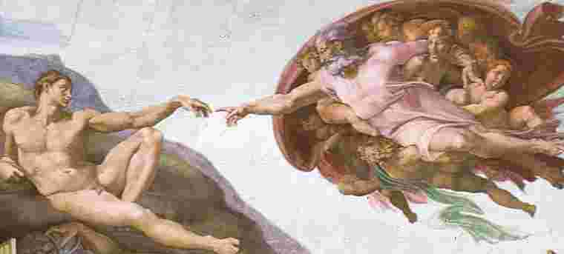
The Renaissance
What is the Renaissance?
Renaissance: Rebirth in art, writing, architecture, learning, and culture.
The educated hoped to bring back to life the culture of classical Greece and Rome
In doing so, they created something entirely new: innovative styles of art and literature
The Renaissance eventually spread from northern Italy to the rest of Europe
Occurred roughly 1300-1600

Slide 8
The Renaissance
Why Italy?
Italy had 3 distinct advantages
City-States
Overseas trade, spurred by the Crusades had led to growth of large city-states
Thus, northern Italy was urban while the rest of Europe was still rural
Cities were the place where people exchanged ideas and the site of an intellectual revolution
Survivors of plague could demand higher wages
Merchants had few opportunities to expand business so they pursued art

Slide 9
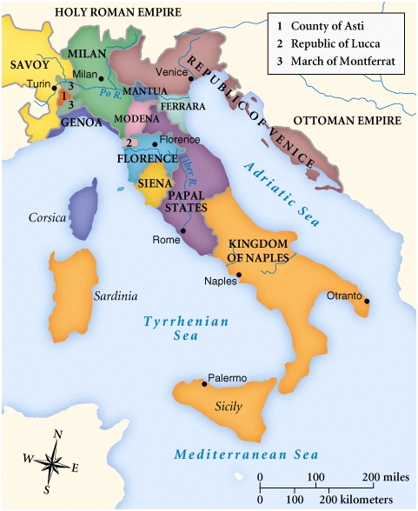
City States
Florence was the epicenter of the Italian Renaissance.

Slide 10
The Renaissance
Merchants and the Medici
A wealthy merchant developed in each Italian city-state
Merchants dominated politics
Merchants did not inherit social rank- used their wits to survive
This lead to the rise of importance of individual merit
The Medici banking family came to dominate Florence
Had branch offices all throughout Italy and Europe
Cosimo de Medici was the wealthiest European of his time
Grandson Lorenzo de Medici became great patron of the arts
Patron: someone who financially supports an artist or the arts

Slide 11
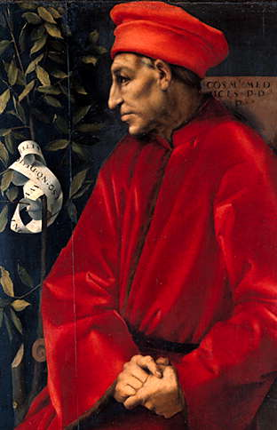
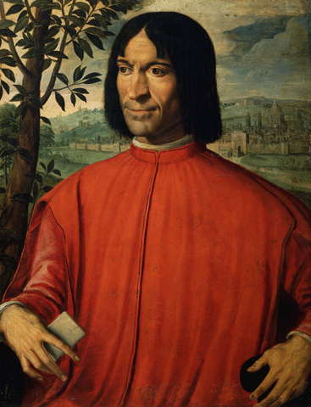
Cosimo de Medici & Lorenzo de Medici

Slide 12
The Renaissance
Classical heritage of Greece and Rome
Renaissance artists looked down on the art and literature of the Middle Ages
Instead they wanted to revive the learning of the Greeks and Romans
Ruins of Rome were nearby
Many Greek manuscripts made their way to Rome via Christian scholars

Slide 13
The Renaissance
Classical and Worldly Views
As scholars studied manuscripts, they became more influenced by classical ideas.
This lead to:
Humanism: an intellectual movement that focused more on human potential and achievements
Popularized the study of history, literature, and philosophy (all are known as humanities)
Worldly pleasure: Humanists suggested that a person could enjoy life without offending God
Ex. Wealthy could enjoy material luxuries, good music, and fine foods

Slide 14
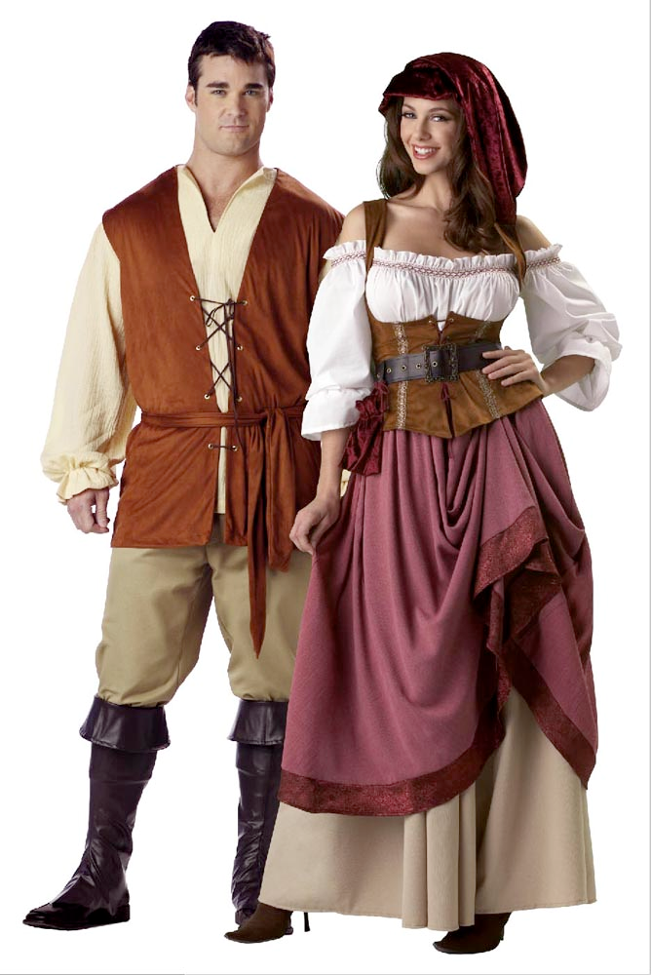
The Renaissance
The Renaissance Man and Woman
Renaissance Man: One strove to be a master in every area of study
Expected to be charming, witty, and well educated in the classics
Also should be a skilled rider, wrestler, and swordsman
Renaissance Woman: Upper-class women should know the classics and be charming
Not expected to seek fame
Inspire art but not create it
Little influence in politics

Slide 15
MACHIAVELLI
Quiz
Machiavelli Personality Test (Computers)
Machiavelli THE PRINCE two text comparison

Slide 16
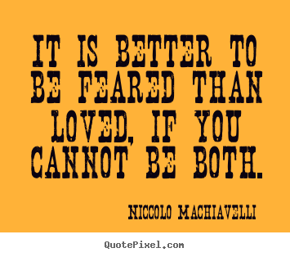

Slide 17
Machiavelli
“The Prince” – “The End justifies the means”
“a man who wishes to act entirely up to his professions of virtue soon meets with what destroys him among so much that is evil.”
Machiavelli counsels that a ruler must act on “the real truth of the matter” rather than “the imagination of it…”
"The Prince" overall idea is the idea of reason/logic over emotion/morals.

Slide 18
Machiavellian Trait Test / 2 Life-Death scenarios:
A train going at 75mph has lost control of its brakes and could not stop. Up ahead of the train are 7 people working on the track, completely unaware of the danger approaching them. As a lowly employee, you have no way of warning or communicating to these people. Fortunately you can save these 7 lives by diverting the train to another track. Unfortunately there are 2 people working on that second track. To make matters worse, those 2 people happened to be your friends and you have no way of communicating with them. What do you do?
a) Divert the train and kill your 2 friends b) Do not divert the train and kill the 7 people

Slide 19
You and 3 friends barely survived a violent shipwreck in the middle of an unknown body of water. You have no medical equipment to treat your injuries, no cell phones or any technological means of communication, no food, and no water (saltwater is undrinkable); all you have are the clothes on your back and the emergency life raft you sitting in. It's been over 2 days and there is still no signs of rescue and your hopes are growing dim. One of your friends (injured from the shipwreck) is suffering from a deep wound infection that has spread to several vital areas of his/her body, dehydration, and starvation. The lack of medical treatment and nutrition has caused him/her to become incoherent, weak, and quite possibly dying. What should you do with him/her?
a) Throw him/her overboard and kill him/her to prevent his/her slow and agonizing death b) Let him/her live and cling on to the small piece of hope that rescue will come soon and he/she will be properly treated

Slide 20
The controversy of torture: should we permit torture (pro: save lives = rationality) or not (con: unethical = emotions)
A Machiavellian leader follows entirely on reason and logic instead of emotions and ethics.

Slide 21
Day 2
HW: Discuss
Machiavelli & Popular Culture
Tupac Comparison
Project

Slide 22
Chapter Fifteen:
Machiavelli writes:
“my hope is to write a book that will be useful, at least to those who read it intelligently, and so I thought it sensible to go straight to a discussion of how things are in real life and not waste time with a discussion of an imaginary world”
Shakur had rapped about things that many people felt were too raw for music.
Hit ‘em with a little Ghetto Gospel
(https://www.youtube.com/watch?v=F_5QCFWZNlk)

Slide 23
Machiavelli: “Hence it is necessary for a prince wishing to hold his own to know how to do wrong, and to make use of it or not according to necessity.”
He says there are things that are virtuous but will lead to your downfall and things that are bad but will make you prosper.
Tupac: “Changes”
“I ain’t never did a crime I ain’t have to do, but now I’m back with the facts giving them back to you”

Slide 24
“It is better to be feared than loved”
Hit ‘Em Up
“Grab your glocks when you see Tupac/Call the cops when you see Tupac/ You shot me but your punks didn’t finish/Now you bout to feel the wrath of a menace”

Slide 25
Machiavelli
The Ends Justify The Means
Better to be feared than loved if you can not be both
The appearance of virtue is more important than virtue itself
sensible to go straight to a discussion of how things are in real life and not waste time with a discussion of an imaginary world”

Slide 26
Make lists of leadership positions in the U.S. (CEOs, heads of labor unions, facilitators of cooperative learning groups, etc.).
Venn diagram. In one circle put characteristics/skills that people want in a good leader.
In the other circle put characteristics/skills that a leader needs to stay in power.
In the intersecting sections, put characteristics/skills that are needed both to wield power well and to keep power.
Machiavelli's attitude toward using and keeping power. How has the situation changed today?

Slide 27
Is Machiavelli maligned undeservedly? Should the term “Machiavellian” be redefined?
Reappraising Machiavelli

