Slide 1
State of Nature
Life w/out a government.
Good? Bad? Why?
Advantages? Disadvantages?
What natural rights do people have in a state of nature? What might happen to these rights?

Slide 2
State of Nature
Disadvantages
Stronger or smarter people might take away other peoples lives, liberty, and property, or
weaker people might band together and take away the lives, liberty, and property of stronger or smarter people.
Advantages
People have unlimited freedom to do what they please.
Natural Rights
Life, liberty, and property are the rights the FOUNDERS had in mind when creating the US Gov.

Slide 3
Bill of Rights
Why do you think the issue of rights were so important to the Framers?

Slide 4
John Locke
His political philosophy is the foundation of American Government.
His conclusion as it relates to individual rights is that:
It is in everyone’s best interest to give up some of the freedom they would have in the state of nature in exchange for protection and security.
Government was necessary in order to protect peoples natural rights.
Agree / Disagree?

Slide 5
Locke vs. Hobbes

Slide 6
REVOLUTION

Slide 7
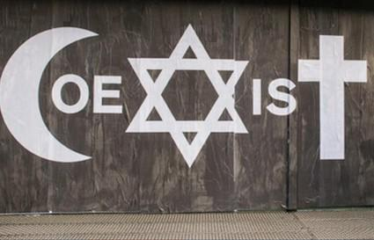
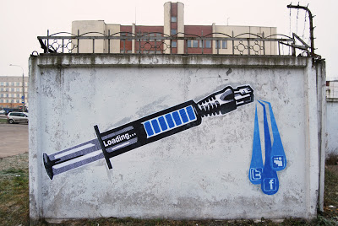
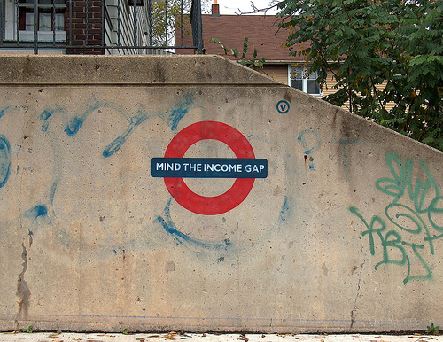
AGREE / DISAGREE
ECONOMICS: A growing economy benefits all people.
CULTURE: Religious differences lead to conflict and bloodshed.
SCIENCE, TECH & SOCIETY: Technology that improves the quality of life for individuals can prove harmful to society as a whole.

Slide 8
AGREE / DISAGREE
AGREE: TECH GIVES A SMALL PERCENTAGE OF PEOPLE A HIGH STANDARD OF LIVING AT THE EXPENSE OF THE WORLD’S ENVIRONMENT.
DISAGREE: ADVANCES IN TECH BENEFIT ALL PEOPLE.
ECONOMICS: A growing economy benefits all people.
AGREE: JOBS AND GOODS ARE PLENTIFUL WHEN ECONOMY IS GROWING.
DISAGREE: ONLY THOSE WITH MONEY & FREEDOM BENEFIT.
CULTURE: Religious differences lead to conflict and bloodshed.
AGREE: CONFLICT OCCURS WHEN ONE GROUP TRIES TO IMPOSE ITS RELGION ON ANOTHER GROUP.
DISAGREE: RELIGIOUS DIFFERENCES ENRICH SOCIETY.
SCIENCE, TECH & SOCIETY: Technology that improves the quality of life for individuals can prove harmful to society as a whole.

Slide 9
Define Revolution:
A revolution (from the Latin revolutio, "a turn around") is a fundamental change in power or organizational structures that takes place in a relatively short period of time

Slide 10
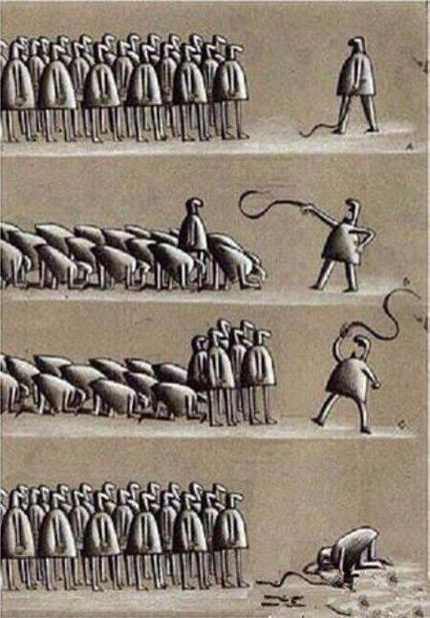
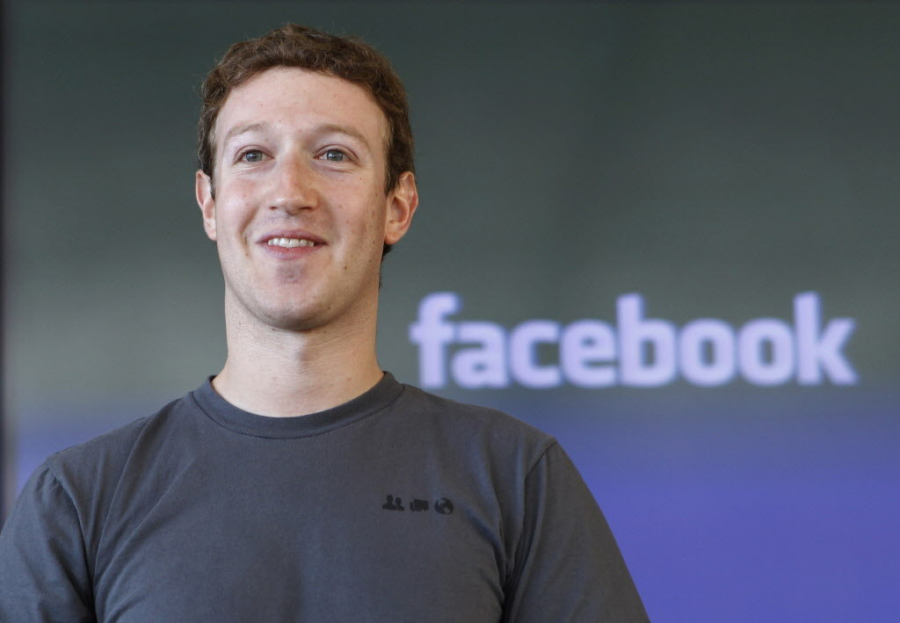
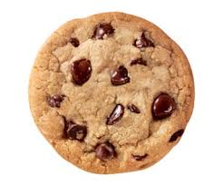
In your opinion, what are some common reasons people might revolt?
What kind of person do you think typically leads a revolution?
Do you think a revolution is something that happens quickly or over time? Why?
Once a government has been overthrown, how long do you think it would take for new leaders to establish a different form of government and make it run effectively?

Slide 12
Part 2
Free Press

Slide 13
How would your local newspaper, television station, or radio station be different if the content was controlled by the government?

Slide 14
Define
free press
censorship
propaganda
fact
opinion
rumor/gossip

Slide 15
Why would a person, group or government:
o be opposed to freedom of the press?
o censor information being presented to the public?
o distribute propaganda to the public?
• How could having complete control of the press give a person, group or government more power?
• How has the technological revolution and the development of new forms of press such as web-based news publications, blogs, podcasts, and satellite television feeds changed the ability of people, groups and governments to control the press?

Slide 16
This Is Water
When do we typically look for a scapegoat / negative – turmoil – how does the press leverage this vulnerability?
YOU CHOOSE TO DECIDE – TAKE IT ALL IN

Slide 17
HW or next day: Comparing Revolutions
Reading Quiz: pg. 611 -617 (or top of 615)
Next day: Control The Press, Control The People

