Slide 1
Roman Republic – The Twelve Tables
Introduction
Campaign-election

Slide 2
Describe location of Italy and how this location might have benefited the growth of the Roman Power. How was Italy helped and hurt by its geography?
- Protected by mountains, helped to control Mediterranean, overland travel made easy, separated from rest of Europe – Vulnerable to enemy attacks from north and sea.

Slide 3
How was Rome helped by its location?
Its location provided defense from sea invasions. Also, Rome lay at a natural river crossing, helping to promote the city as a hub of overland trade and transportation.

Slide 4
Agree / Disagree Government: A strong army and government are necessary to maintain an empire.
Agree: A strong army and government help ensure order and peace among diverse peoples
Disagree: Cooperation among different groups and a sense of unity are more important to an empire than a strong army and gov.

Slide 5
CULTURE: Great civilizations build on the discoveries, developments, and contributions of earlier cultures.
Agree: The contributions of earlier cultures provide a great foundation for a later cultures progress.
Disagree: A culture that depends upon another’s contributions will not be innovative and unique, characteristics that are key to greatness.

Slide 6
GLOBAL RELATIONS: An empire that enslaves conquered peoples is destined to fall.
Agree: An empire that enslaves conquered people creates hatred and resistance toward its rule.
Disagree: By enslaving conquered peoples, an empire ensures control over those who might threaten its rule.

Slide 7
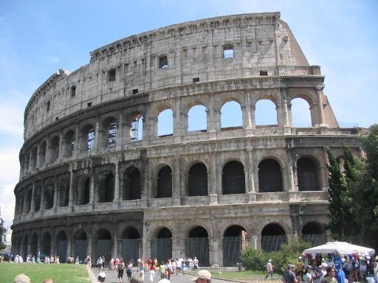
Ancient Rome
Roman Kingdom
753-509 B.C.
Roman Republic
509-27 B.C.
Roman Empire
27 B.C. – 476 A.D.

Slide 8
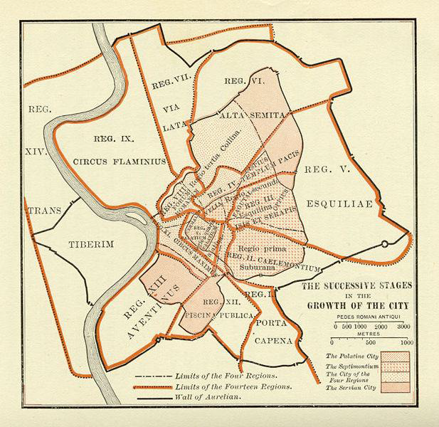
The Roman Kingdom
What is a kingdom?
In Rome, it was a monarchical government that ruled over Rome and its neighbors
There was a Senate, but no elections, only appointments by the King
In 509, the last king (Tarquinius) is overthrown and a Republic is established

Slide 9
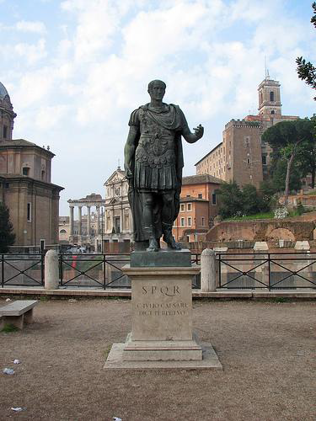
The Roman Republic
Est., 509 B.C.
Republic: A form of gov in which voters elect officials to run the state.
Differences?
Some separation of powers, checks and balances, elected Senators
3 important groups of citizens helped govern the republic: The senate, the magistrates, and a variety of popular assemblies.
Only adult male citizens were entitled to vote and to take part in gov.

Slide 10
Magistrates
Senate: Most influential and powerful of the three because it controlled…..
$$$ public funds and foreign policy.
In times of emergency, the senators could propose that citizen be named dictator – could rule for up to six months.
Consuls: 2 individuals were elected to one year terms to serve as consuls, or chief executives.
- Ran gov, commanded the army, and could appoint dictators. Governed with advice of Senate.
Veto (Latin word means “I forbid)
- Balance of power.
Praetors (pree-tuhrz): Elected to help consuls, in times of war help command army, in times of peace oversaw Roman legal system.

Slide 11
Conflict of the Orders
Patricians and Plebeians
Elite families vs. middle class/ workers /poor people/slaves
Patricians enforce laws
Plebeians demanded written laws
Why?
Because of the Plebeians great numbers advantage, the Patricians had to agree

Slide 12
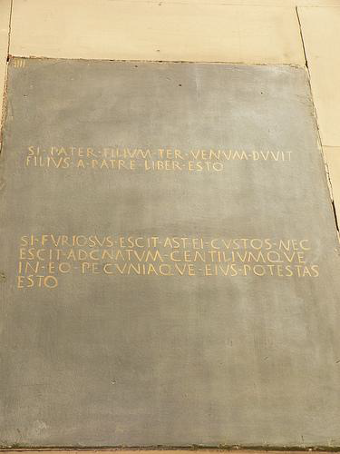
The Twelve Tables
For many years Plebians had few rights – could vote, but not hold office, and laws were vague because they were not written down.
In about 450 b.c. huge victory – forced the gov to write down the laws of the Roman Republic – 12 Tables.

Slide 13
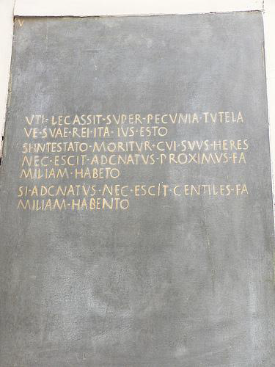
They were NOT a comprehensive statement of all law
They are a list of privately held rights and procedures
Similar to a ___ _ ___?
Bill of rights
They combine strict and rigorous penalties with equally strict and rigorous procedures

Slide 14
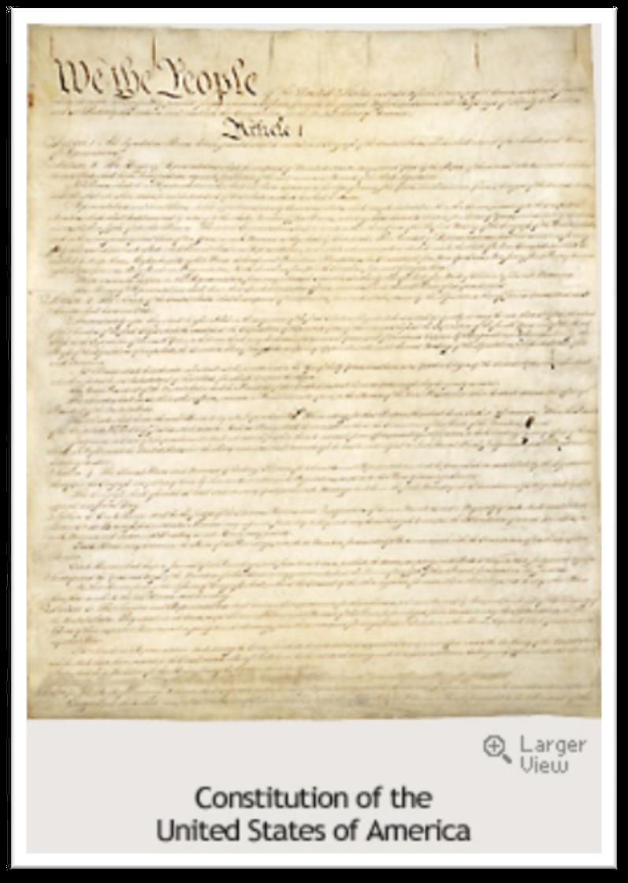
So, the 12 Tables form the basis of Roman law and the centerpiece of the Roman Republic
Significance?
They’re the first thing that even resembles a Constitution or Bill Of Rights

