Slide 1
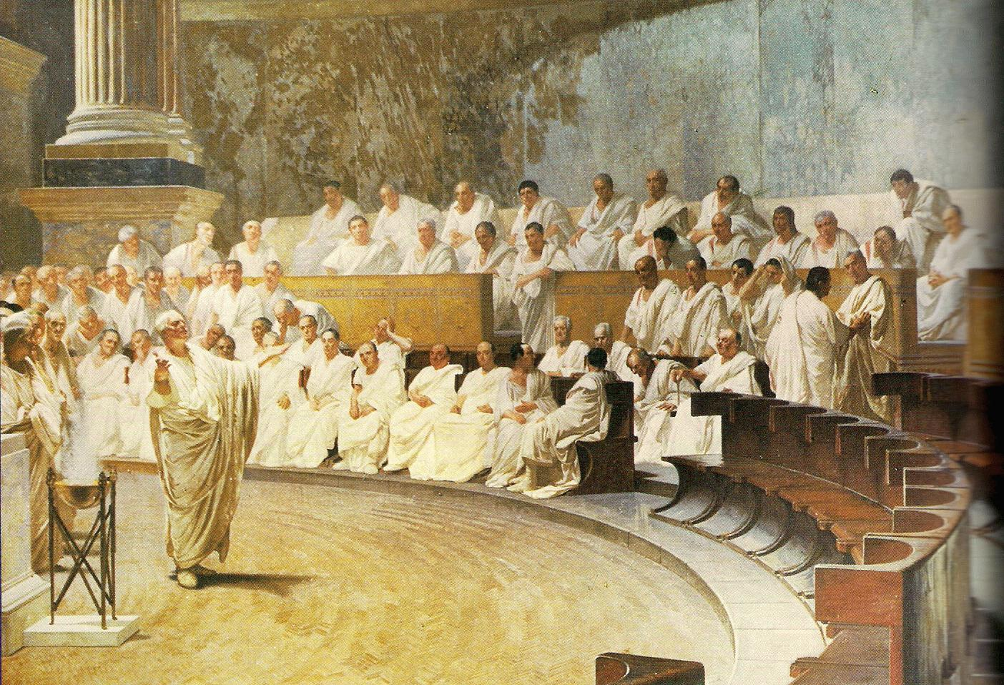
Ancient Rome & The Origin of Christianity
Outcome: A Republic Becomes an Empire

Slide 2
Benjamin Franklin observed
“we have a Republic — but only if we can keep it.”

Slide 3
1 — Loss of the Spirit of Compromise:
The Roman Republic, like ours, relied on a system of checks and balances. Compromise is needed for this type of system to function.
In the end, the Roman Republic lost that spirit of compromise, with politics increasingly polarized between Optimates (the rich, entrenched elites) and Populares (the common people).
Sound familiar? Compromise is in noticeably short supply in our own time also. For example, “There were more filibusters between 2009 and 2010 than there were in the 1950s, 1960s and 1970s combined.”

Slide 4
2 — Collapse of the Middle Class:
In the period just before the Roman Republic’s fall, the Roman middle class was crushed — destroyed by cheap overseas slave labor.
In our own day, we’ve witnessed rising income inequality, a stagnating middle class, and the loss of American jobs to overseas workers who are paid less and have fewer rights.

Slide 5
3 — Profits Made Overseas Shape the Republic’s Internal Policies:
As the fortunes of Rome’s aristocracy increasingly derived from foreign lands, Roman policy was shaped to facilitate these fortunes.
Globalized Economy

Slide 6
4 — Staggering Increase in the Cost of Elections, with Dubious Campaign Funding Sources:
Our 2012 election reportedly cost $3 billion. All of it was raised from private sources – often creating the appearance, or the reality, that our leaders are beholden to special interest groups. During the late Roman Republic, elections became staggeringly expensive, with equally deplorable results. Caesar reportedly borrowed so heavily for one political campaign, he feared he would be ruined, if not elected.

Slide 7
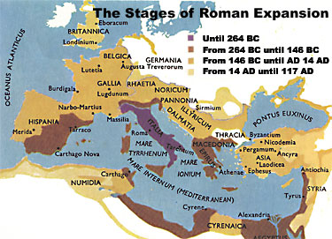
A Republic Becomes an Empire
Setting the Stage
With the defeat of Carthage in the Punic Wars, Rome was proving to be the biggest and most powerful civilization on the Mediterranean
The larger Rome’s territory got, the more unstable the republic form of government became

Slide 8
A Republic Becomes an Empire
The Republic collapses
Rome’s increasing wealth and expanding territories brought problems
Discontent among lower classes
Breakdown in military order

Slide 9
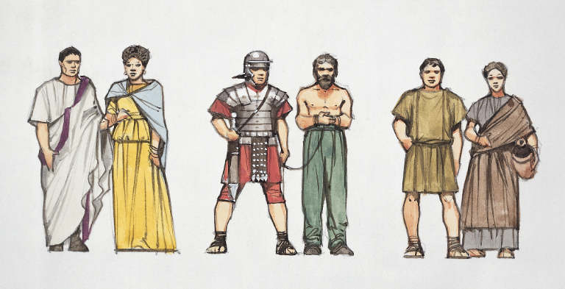
A Republic Becomes an Empire
Economic Turmoil
Gap between rich and poor widened
Rich lived on huge estates
Poor worked on estates (possibly as slaves)
By 100 B.C. one-third of Rome’s population were enslaved

Slide 10
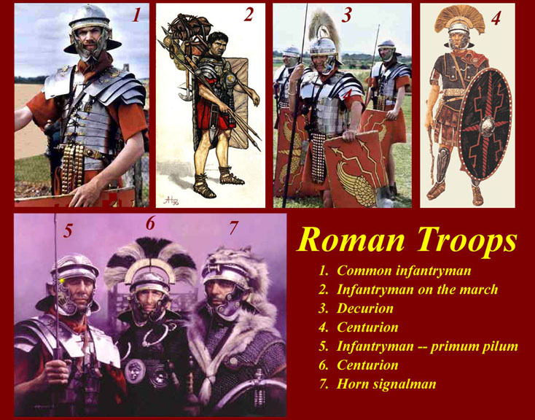
A Republic Becomes an Empire
Military Upheaval
Generals seized power for themselves
Recruited by promising land
Citizens loyal to generals rather than to Rome itself

Slide 11
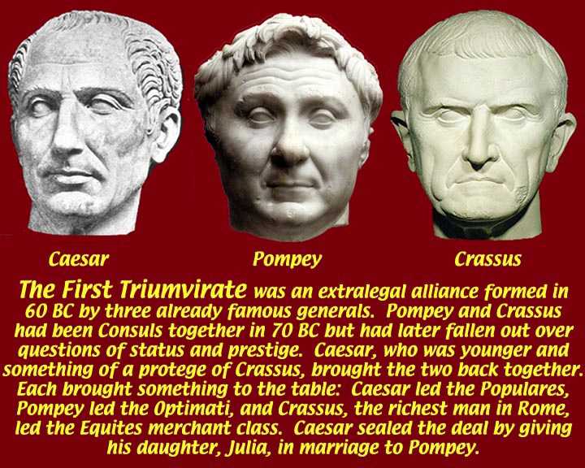

Slide 12
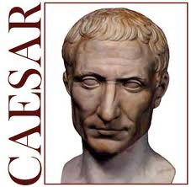
Caesar – One of his greatest qualities was his willingness to show mercy to his defeated enemies. How might the history of the Roman Republic have been different if Caesar had shown less mercy?
Might not have been murdered.

Slide 14
START
Cicero: 6 mistakes of Man
ANTICIPATION GUIDE: Complete / Discuss
What effect did Mediterranean conquest have on the Roman social class system?
Created a new class of wealthy generals, officials, and traders, as well as a class of slaves from war captives
What values replaced simplicity, hard work, and devotion to duty?
Greed, self interest – Unrest at home as the gap between rich and poor widened, and increased corruption.
You have heard the saying, "The rich get richer and the poor get poorer." What does this mean?

Slide 15
On what day was Caesar killed?
40 years before Caesar’s rule, a commander named Sulla unintentionally influenced a young Caesar, how so?
As a young man, Caesar has a famous name, but no wealth, what are his most valuable “weapons” at this time?
What is ironic about Caesar’s method of achieving the title of the highest priest in Rome?
Give two reasons why Brutus probably didn’t like Caesar very much.
Where did Caesar die?

Slide 16
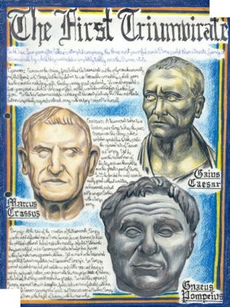
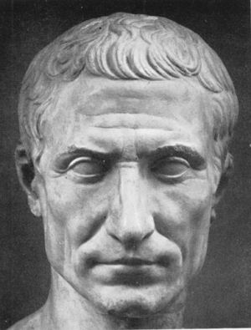
A Republic Becomes an Empire
Julius Caesar
60 B.C. joins with Crassus (wealthy Roman) and Pompey (popular general) to create a Triumvirate
Triumvirate: a group of three rulers
They rule together for 10 years

Slide 17
A Republic Becomes an Empire
Caesar takes power
Caesar has success in Gaul (France), becomes quite popular
Political rival Pompey urges the senate to disband Caesar’s legions
Caesar defies senate, marches into Rome
Pompey flees
Caesar defeats Pompey’s troops in Greece, Asia, Spain, and Egypt
Julius Caesar returns home in 46 B.C.- senate appoints him dictator
44 B.C. Caesar is named dictator for life
Result: Even though Caesar has total control, Rome still embraces some of its republic roots, however it is moving closer to empire

Slide 18
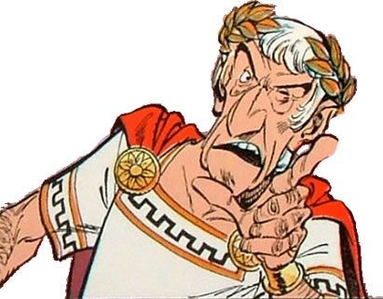
A Republic Becomes an Empire
Julius Caesar’s legacy
Absolute ruler but he also expanded the senate
Granted citizenship to people in Roman provinces
Helped poor by creating jobs and building projects
Increased pay for soldiers

Slide 19
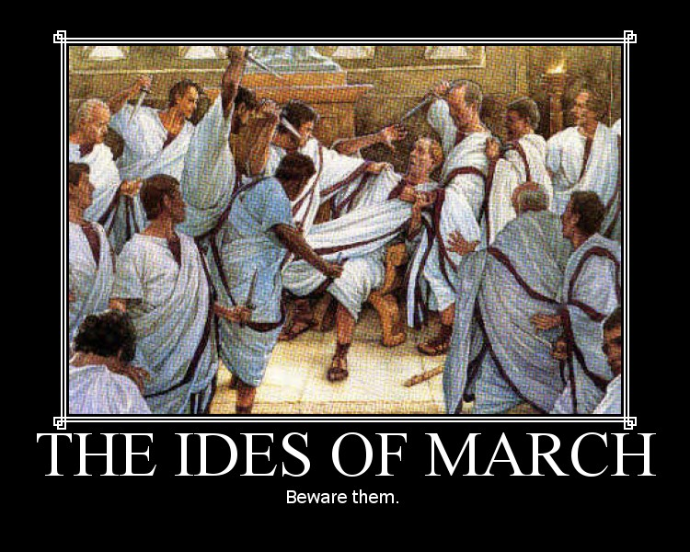
A Republic Becomes an Empire
Beware the Ides of March
Many nobles and senators expressed concern over Caesar’s growing power, success, and popularity; feared losing their influence
Others considered Caesar a tyrant
Many felt Rome would suffer due to his ego
Caesar is stabbed to death in the senate by a gang of senators led by Marcus Brutus and Gaius Cassius on March 15, 44 B.C.

Slide 20
Death of Caesar

Slide 21
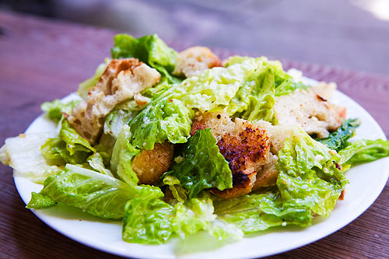
Really?

Slide 22
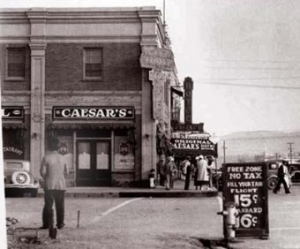
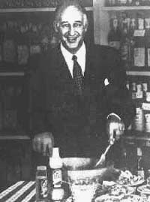
http://www.todayifoundout.com/index.php/2010/09/caesar-salad-was-named-after-caesar-cardini-not-a-roman-emperor/

Slide 23
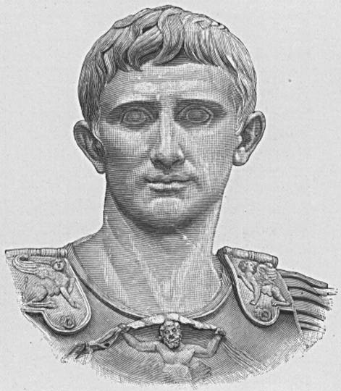
Octavian

Slide 24
Hereditary rule is an effective means for choosing a well qualified leader with the best interests of his / her country in mind.
When a leader is cruel, incompetent, unfair, or disloyal to the people he / she is leading, it is acceptable to forcibly remove the person from office by whatever means necessary.

Slide 25
When a leader is chosen to rule for life, he / she should trust no one because of the vast amount of absolute power that comes with the leadership role.
When in a position of great power, it is sometimes necessary to make personal sacrifices, even if they are extremely painful on a personal level.

Slide 26
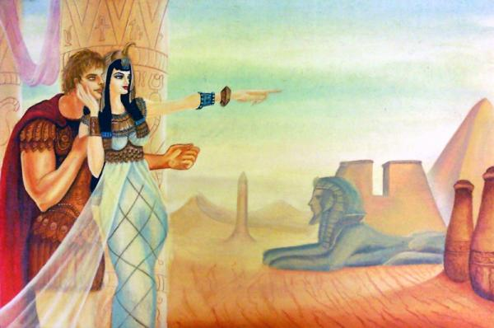
A Republic Becomes an Empire
Octavian
Caesar’s 18 year old nephew and adopted son
Takes power with Mark Antony and Lepidus = Second Triumvirate
Octavian forces Lepidus to retire
Mark Antony falls in love with Queen Cleopatra of Egypt

Slide 27
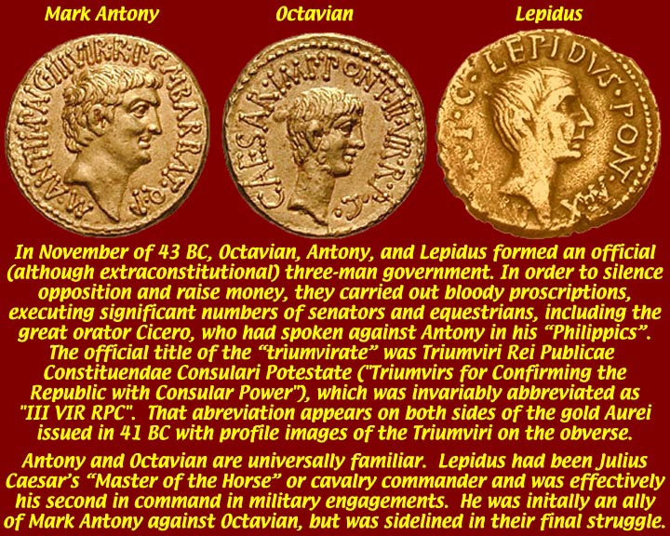
Second Triumvirate

Slide 28
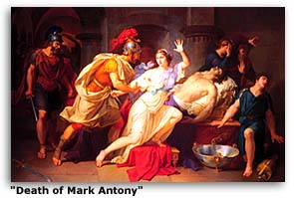
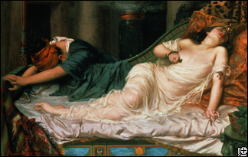
A Republic Becomes an Empire
Octavian
Octavian accuses Antony of plotting to rule Rome from Egypt and this leads to another civil war
Octavian defeats Antony & Cleopatra’s forces at naval battle of Actium (31 B.C.)
Mark Antony and Cleopatra commit suicide; leaving Octavian sole leader
Octavian takes name Augustus meaning “exalted one” -27 B.C.

Slide 29
From Octavian to Augustus
Octavian Takes Power
Octavian faced task of restoring order in empire
Had no intention of establishing dictatorship when he took power
New Political Order
Octavian decided it impossible to return Rome to republican form of government
Created new political order, known today as the empire
Principate
Octavian careful to avoid title of king or emperor
Called himself princeps, “first citizen”
Government called Principate
New Title
27 BC, Senate gave Octavian title Augustus, “the revered one”
Title a religious honor; able to wear laurel and oak leaf crown

Slide 30
The Augustan Age
New Imperial Government
Augustus head of state more than 40 years, made smooth transition to new imperial government with power divided between him and Senate
Most financial, administrative matters under Augustus’s control
Foreign Affairs
Started program to bring peace to west, particularly to Gaul, Spain
Began series of conquests that pushed border eastward to Danube River
Also took special care of Rome itself
Legacy
Created police force, fire brigades; stockpiled food, water
Began building program; presided over moral, religious reforms
Great period of cultural creativity; great writers like Horace, Ovid, Virgil

Slide 31
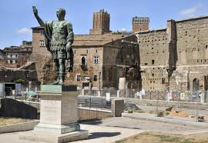
How does this sculpture demonstrate a new Roman view of a divine ruler?
Greatness and supremacy

Slide 32
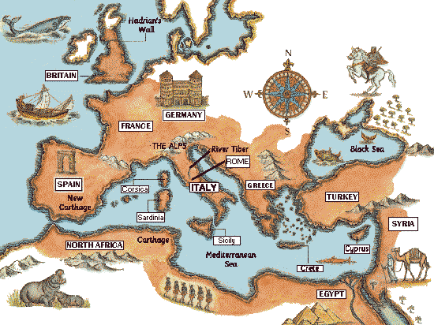
A Republic Becomes an Empire
Result: Rome is officially an empire.

Slide 33
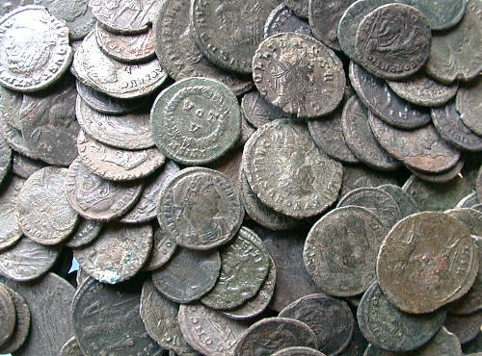
A Republic Becomes an Empire
A Vast and Powerful Empire
Peak of Rome’s power 27 B.C. to 180 A.D.
Period known as the Pax Romana or “Roman Peace”
Population of 60-80 million with 1 million in the city of Rome
Rome held together through efficient means of government started by Augustus however many terrible emperors would gradually weaken the empire over the next 400 years
Common coinage made trade easier
More Roman Coins

Slide 34
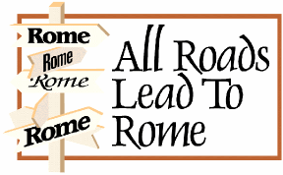
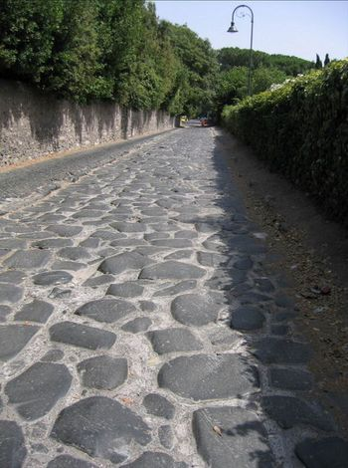
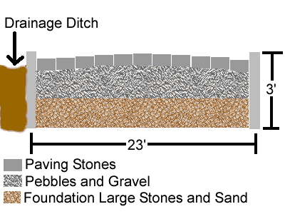
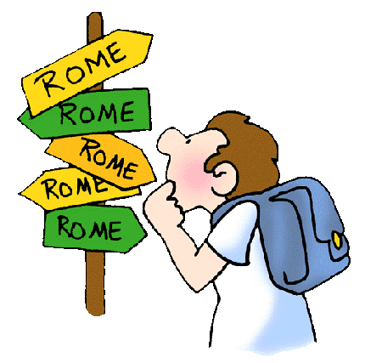
A Republic Becomes an Empire
“All roads lead to Rome;” the Romans built about 250,000 miles of roads

Slide 35
END

Slide 36
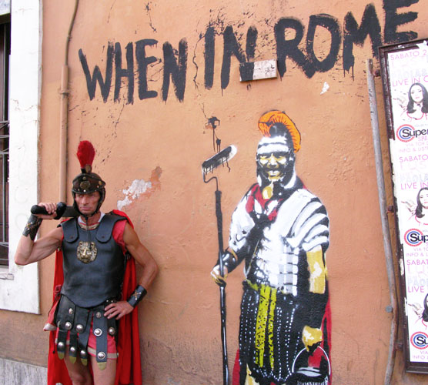
Ever heard this phrase…?

Slide 37
Not so much…

Slide 38
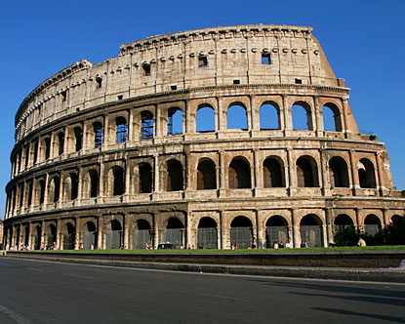
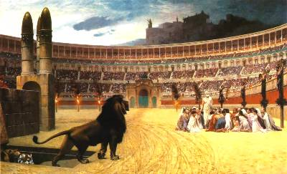
A Republic Becomes an Empire
The Colosseum was used to distract the masses because much of city of Rome was unemployed; gladiatorial battles were popular for entertainment
Rich continued to live extravagantly

Slide 39
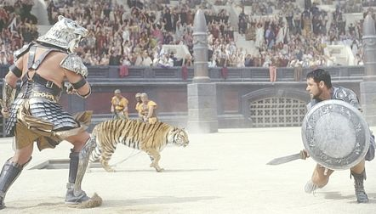
Gladiatorial Battles

Slide 40
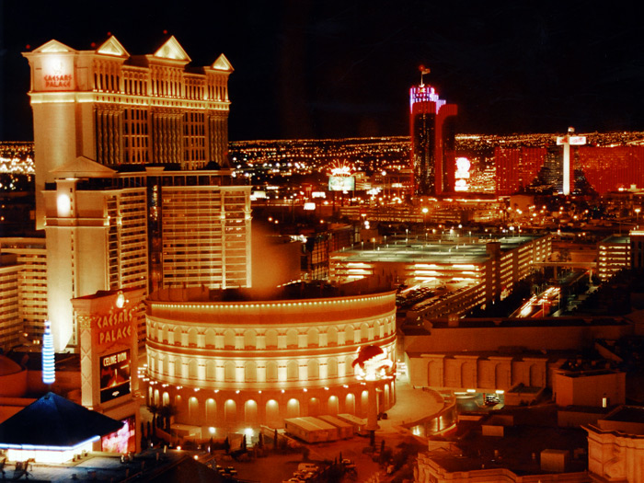
The Colosseum at Caesar’s Palace

Slide 41
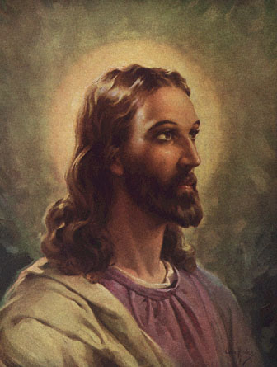
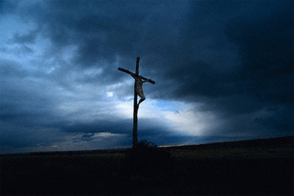
A Republic Becomes an Empire
Coming up next: The works of Jesus of Nazareth and Christianity would change the world forever

Slide 42
Who Can Be A Citizen
Citizen:
A citizen is a person who owes loyalty to a country and receives certain rights in return.
As of 2011, everyone born in the US, or born to U.S. citizens overseas, automatically becomes a U.S. citizen. However, for an adult immigrant to become a citizen, he or she must go through a process called naturalization, which includes the eight requirements listed below.
With a partner, discuss each requirement. Then check whether or not you support it. If you and your partner disagree, make two check marks.

Slide 43
Must be at least 18 years of age
Must have been legally admitted to the U.S. (holder of a green card)
Must have lived in the US for at least 15 years (if single)
Must have lived int eh US for at least 3 years (if married to a US citizen)
Must have no prison record
Must be able to speak, read, and write English.
Must pass a test on us history and the Constitution
Must swear allegiance (loyalty) to the US

Slide 44
Part II
There have been proposals to add other citizenship requirements. Which of the following would you support?
Must perform one year of national service, either in the military or a public agency like a school or the National Park Service
Must have graduated from high school or received a GED certificate.
Must be in school, have proof of employment, or proof of a net worth of $100k.

Slide 45
Should millions of undocumented immigrants with no criminal record be allowed to live and work in the United States without fear of getting deported?
– Should unauthorized immigrants in the United States be allowed to apply for citizenship eventually?
– Or, do you believe that undocumented immigrants should be required to leave the United States?

